Slide 1
Network Visualization using R
Bomi Lee

Slide 2
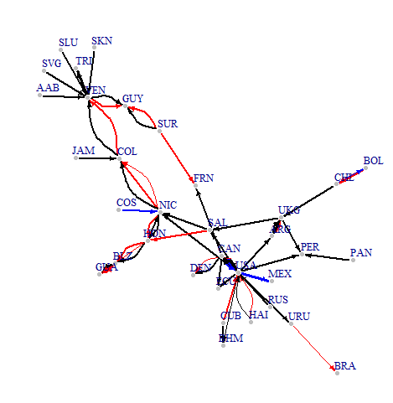

Slide 3
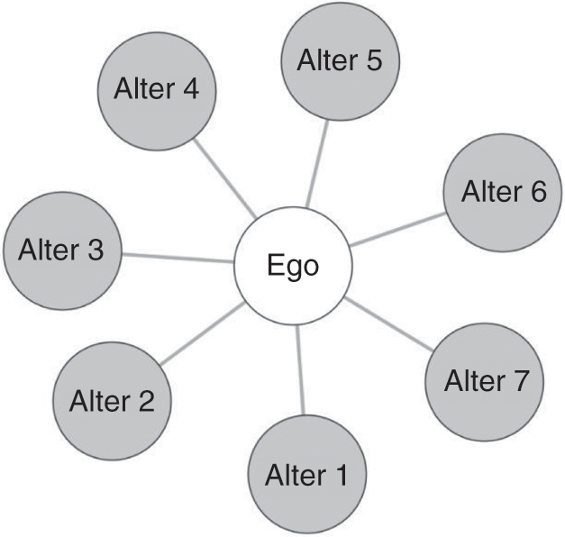
Terms
A network is a collection of nodes joined by edges
Whole network
Complete universe of cases
Sample Networks
Ego-net
Questions to ask if ego net
Who is the ego?
How many steps removed are you going from the ego?
Respondent-driven sample
Some combination of the two (multiple ego nets, etc)

Slide 4
Terms
Node- unit we are examining
Could be countries, people, cities, etc.
Synonyms: Vertex, Sites, Actors
Tie- connection between two nodes
Directed or undirected?
Example directed: giving money to a person
Example undirected: friendship, conversation
Binary or Valued?
Do you only care if a tie exists?
Do you care about the nature of the tie?
Synonyms: Edge, Link, Bond

Slide 5
Relationship?

Slide 7
Data: Adjacency Matrix vs Edge list
Adjacency Matrix- values show connection between nodes
Often omit 0, just care about 1 if binary

Slide 8
Edge list
2 columns- node 1, node 2
Sometimes 3rd column for weight if not binary
Missing edges not included (usually)

